Slide 1
Sprint 29 - Sprint Demo
HPE NFV Telco Blueprint
24th Oct 2019

Slide 2
Sprint 29 Demo - Agenda
# | Demo Topic | Presenter | Duration (Mins)
1 | Infra Infra Document Highlights C8 - BOM, Portmap & Rack diagram for Resource Expansion Kit C9 - Starter Kit Portmap & Rack diagram | Rohith T P | 10
2 | QA QA Cycle-1 End-to-end installation QA Cycle-2 End-to-end installation QA Test Reports QA Bug Reports | Keerthy | 15
3 | NPS Highlights | Anusha | 5
4 | VIM Highlights RHOCP 4.2 Deployment Demo | Nischith Uday | 15
5 | CEPH Storage Performance Highlights | Ranjeet/Tejas | 20
6 | NIC Performance | Shruti | 5
7 | Documentation C8 Highlights Information Center document highlights Walk through of C8 Deployment Runbook and Release notes | Vaibhav | 10

Slide 3
Infrastructure

Slide 4
Infrastructure Highlights
C8 - Resource Expansion Kit
Rack Diagram
BOM
Portmap
C9 - Starter Kit
Port map
Rack diagram
Infra documents Link :
https://hpe.sharepoint.com/:f:/r/teams/NFV_engr/Blueprints/Shared%20Documents/Engineering/Releases/C8%20(VMWare)/Infra?csf=1

Slide 5
QA

Slide 6
QA Highlights
Two cycles of QA End-to-End Installation and Functional Testing - Completed
OpenVAS Testing - Completed
Recording of C8 installation – Completed
The recording is uploaded to the nfvbits server under the location /home/nfvadmin/qa_videos/C8_VMware_Installation_Video
Time matrix capture for installation - Completed
Manual installation of vmware cloud with all optools takes 19 hrs
Automated installation of vmware cloud with all optools except Network Insight takes 3.36 hrs
Automated installation of vmware cloud with all optools including manual installation of Network Insight takes 4.36 hrs
Automated installation of vmware cloud with all optools, manual SRIOV cluster and additional resource node addition takes 7.36 hrs

Slide 7
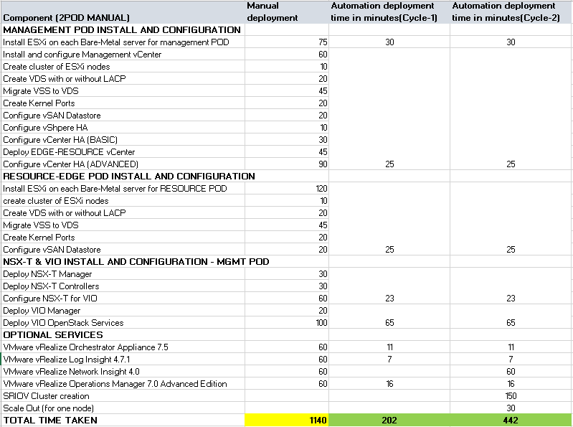
Time Matrix for 2 POD VMware Installation

Slide 8
C8 Test Status from Cycle-1 and Cycle-2 testing
Task​ | Status​
Smart CID and Standalone TICG | Completed
Repo VM and artifacts creation | Completed​
Remote NPS Toolkit installation | Completed​
Upload json and validate json | Completed​
Data switch Automation | Completed​
Enabling & disabling DHCP service on RemoteNPS VM | Completed​
Hardware Preparation​ | Completed
Image service installation and configuration | Completed
VIM deployment through “auto-deploy” and individual commands | Completed​
OpTools (LogInsight, Orchestrator & Operations Manager) deployment through automation | Completed​
Network Insight Manual Installation and configuration | Completed​
OpenVAS Testing, Functional Testing, Negative Testing | Completed​
SRIOV Cluster creation | Completed​
Scale-Out Testing | Completed
Yardstick Testing, Shutdown/Startup Testing and Failover Testing | In Progress

Slide 9
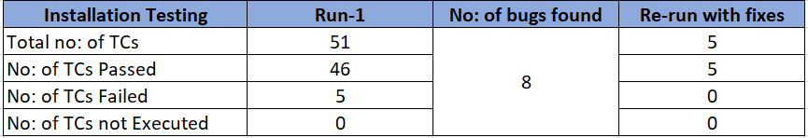

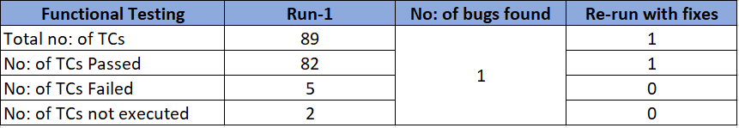
QA End to End Test Report
QA Cycle-1 Test
QA Cycle-2 Test
Functional & Negative Testing

Slide 10
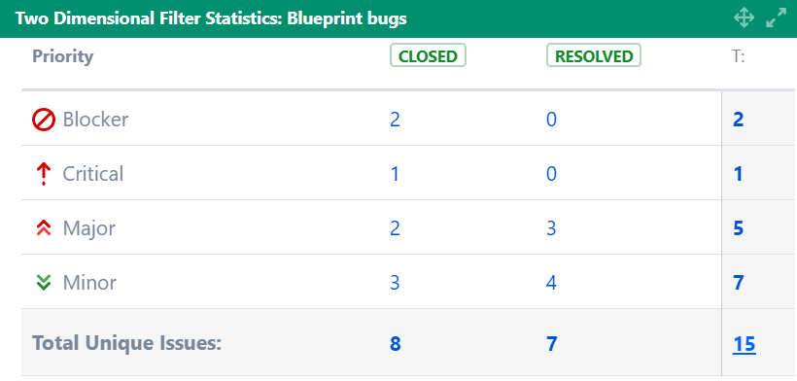
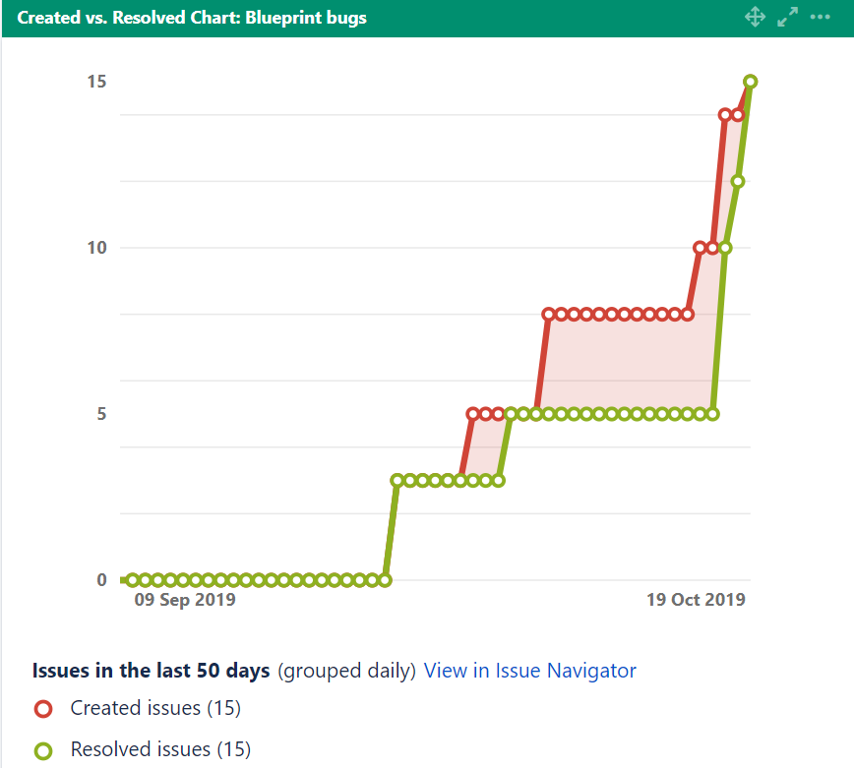
Bug Statistics

Slide 11
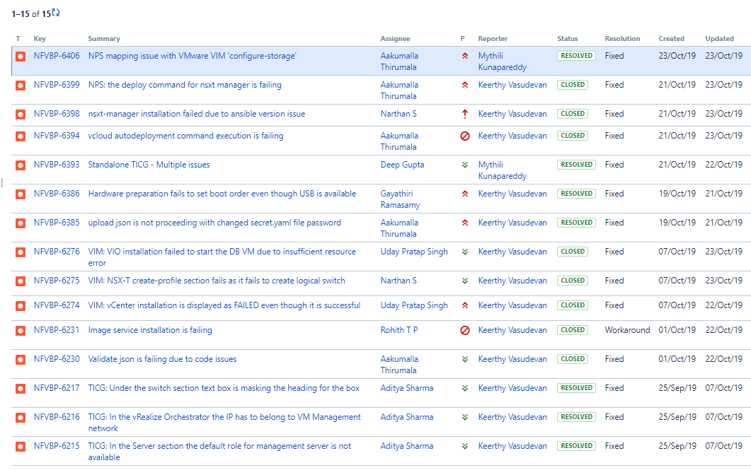
Bug List

Slide 12
Security Test Report (OpenVAS)
Host | Issue | Severity | Solution type | Solution
Remote NPSVM | 1. CentOS Update for bpftool CESA-2019:2829 centos7 2. SSH Weak Encryption Algorithms Supported 3. TCP timestamps | 1. High 2. Medium 3. Medium | 1. Vendor Fix 2. Mitigation 3. Mitigation | 1. Update the kernel. 2. Disable the weak encryption algorithms. 3. To disable TCP timestamps on linux add the line 'net.ipv4.tcp_timestamps = 0' to /etc/sysctl.conf.
Management Servers | 1. TCP timestamps | 1. Low | 1. Mitigation | 1. To disable TCP timestamps on linux add the line 'net.ipv4.tcp_timestamps = 0' to /etc/sysctl.conf
Resource Servers | 1. TCP timestamps. | 1. Low | 1. Mitigation | 1. To disable TCP timestamps on linux add the line 'net.ipv4.tcp_timestamps = 0' to /etc/sysctl.conf
5900 Switch | 1. Deprecated SSH-1 Protocol Detection 2. SSH Weak Encryption Algorithms Supported 3. FTP Unencrypted Cleartext Login 4. SSH Weak MAC Algorithms Supported | 1. High 2. Medium 3. Medium 4. Low | 1. Vendor Fix 2. Mitigation 3. Mitigation 4. Mitigation | 1. Reconfigure the SSH service to only provide / accept the SSH protocol version SSH-2. 2. Disable the weak encryption algorithms. 3. Enable FTPS or enforce the connection via the 'AUTH TLS' command. Please see the manual of the FTP service for more information. 4. Disable the weak MAC algorithms.
SN2100 Switch | 1. Debian LTS Advisory ([SECURITY] [DLA 1637-1] apt security update) 2. Debian LTS Advisory ([SECURITY] [DLA 1955-1] tcpdump security update) 3. Debian LTS Advisory ([SECURITY] [DLA 1917-1] curl security update) 4. Debian Security Advisory DSA 3421-1 (grub2 - security update) 5. Debian LTS Advisory ([SECURITY] [DLA 1931-1] libgcrypt20 security update) 6. Debian LTS Advisory ([SECURITY] [DLA 1909-1] freetype security update) 7. TCP timestamps | 1.High 2.High 3.High 4.Medium 5.Medium 6.Medium 7.Low | 1.Vendor Fix 2.Vendor Fix 3.Vendor Fix 4.Vendor Fix 5.Vendor Fix 6.Vendor Fix 7.Mitigation | 1. Upgrade apt packages 2. Upgrade apt packages 3. Upgrade apt packages 4. Upgrade apt packages 5. Upgrade apt packages 6. Upgrade apt packages 7. To disable TCP timestamps on linux add the line 'net.ipv4.tcp_timestamps = 0' to /etc/sysctl.conf

Slide 13
NPS

Slide 14
NPS Highlights
C8
QA Support – Completed
Document review - Completed
C9
Online NPS installation for RHOCP - Completed
Data model changes for RHOCP - In progress
NPS CLI and REST API changes for RHOCP - In progress
TICG changes for RHOCP - In progress
Investigation on BareMetal provisioning for RHCOS - In progress

Slide 15
VIM

Slide 16
VIM Highlights
C8 (VMware)
Validation and Documentation of Startup/Shutdown procedure for NFV vCloud 3.1
Automation support to configure NUMA and lcore properties for NVDSE
Automation to disable LB on resource ESXI nodes
Runbook update and review
C9 (RHOCP)
Manual deployment of RHOCP 4.2 in dev setup

Slide 17
Services | Components | Scope
Ancillary services (Pre-req): | DNS | Customer
 | DHCP | NPS
 | External LoadBalancer | Customer
 | Internal LoadBalancer | Customer
 | PXE(iPXE) | NPS
 | Bastion | NPS
 | Web Server | NPS
OpenShift Cluster | Boostrap (VM) | Will run on host as VM
 | Master nodes (3x) | 3x Baremetal server
 | Worker nodes (2x) | 2x Baremetal server

Slide 18
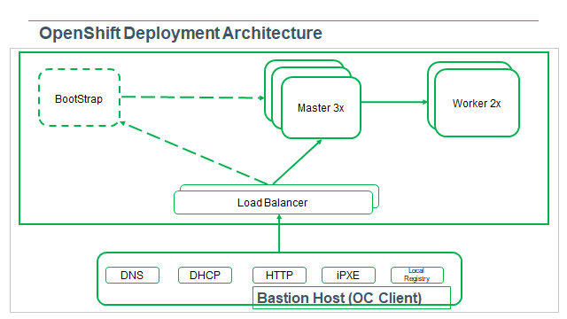
OpenShift Deployment Architecture

Slide 19
CEPH Performance

Slide 20
CEPH Performance highlights
Functional Area | High Level Activities
(RHOSP13+Ceph 3.3 BlueStore) | Completed Data collection with changing Replication Factor (21/15/9 SSD as OSD Bluestore). Data collection with Scrubing disabled (21/15/9 SSD as OSD Bluestore). Data collection with Tuning parameters (21/15/9 SSD as OSD Bluestore). Analysis for SSD data. Report Creation for SSD tests. Network Segregation Test with/without FIO (OSD In/Out, Node In/Out, PG Modification) In-Progress Data collection and analysis for Tuning Ceph Bluestore SSD Cluster Best Practice Guide update with Network Segregation Test Findings Next Steps Compute Node addition for Ceph Bluestore SSD Cluster Bluestore with Write Intensive SSD disks Bluestore with NVMe as OSD Study the impact of aged / filled CEPH stores. Test with 25G FLR NIC on Ceph Nodes Impact of IOPS by different RPM HDD Disk (10K or 15K)

Slide 21
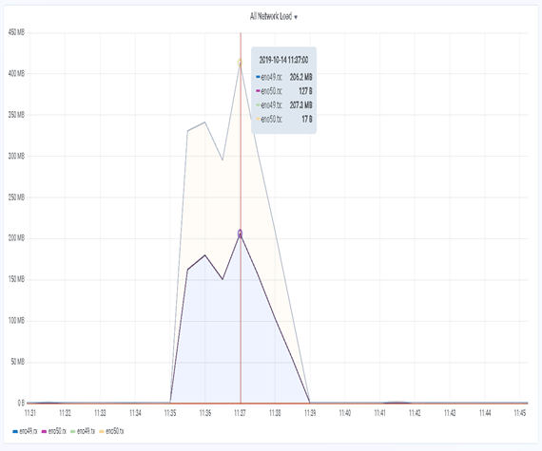
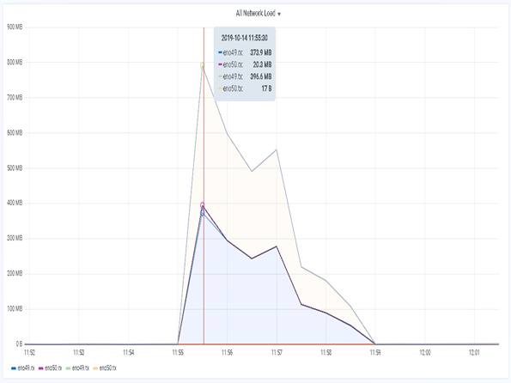
When 1 and 2 OSDs removed (Out of Ceph Cluster) (NO FIO)

Slide 22
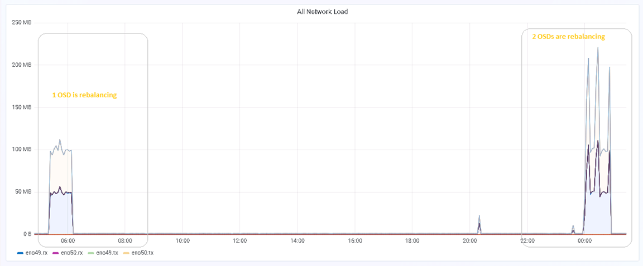
When 1 and 2 OSDs coming up (In Ceph Cluster) (When No FIO)

Slide 23
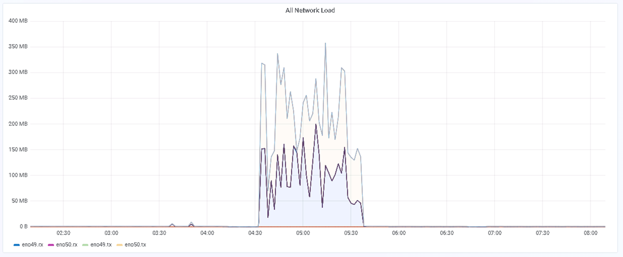
When modifying the PG (Placement Group) (No FIO)

Slide 24
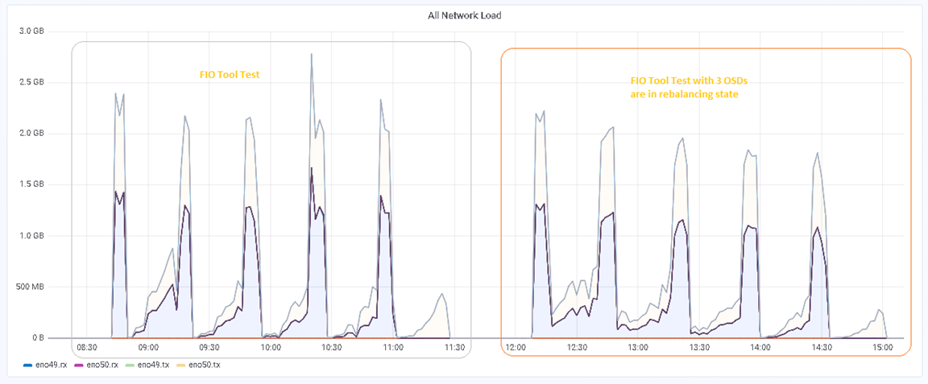
When 3 OSD are coming up (When FIO running)

Slide 25
Report Review Ceph Characterization on DL380 G10 (CLX) with SAS SSD (OSD) and SAS SSD (Journal)

Slide 26
NIC Performance

Slide 27
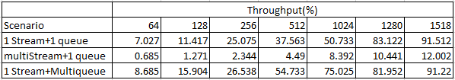
NIC Performance
Functional Area | High Level Activities
OVS-DPDK bonding test with RHOSP13 + DL360 + HPE 661 NIC+"balance-slb" with lacp=active | Current Status: After ovs minor upgrade , both the slave ports are getting selected from bond and observing best throughput with balance_slb +single traffic stream +multiqueue As per RH , single stream traffic would not distribute the traffic on both members of bond and recommendation is to use multistream traffic Dependency on RH: Validate behavior of a single stream traffic distribution in balance-slb+lacp slave dpdk port as it is currently distributed in both slave ports. Configurations to execute multistream traffic in balance-slb+lacp bond as we noticed very low throughput with multistream.

Slide 28
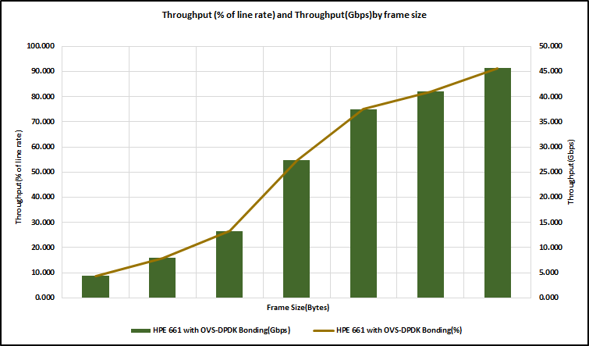
Throughput for ovs-dpdk bonding

Slide 29
Documentation

Slide 30
Documentation Highlights
C8 Release
Highlights of C8 Documentation.
Compatibility Matrix
Technical Solution Brief
Highlights of HPE Telco Blueprint Information Center document
Walk through of C8 Deployment Runbook and Release Notes.

Slide 31
Thank You

Slide 32
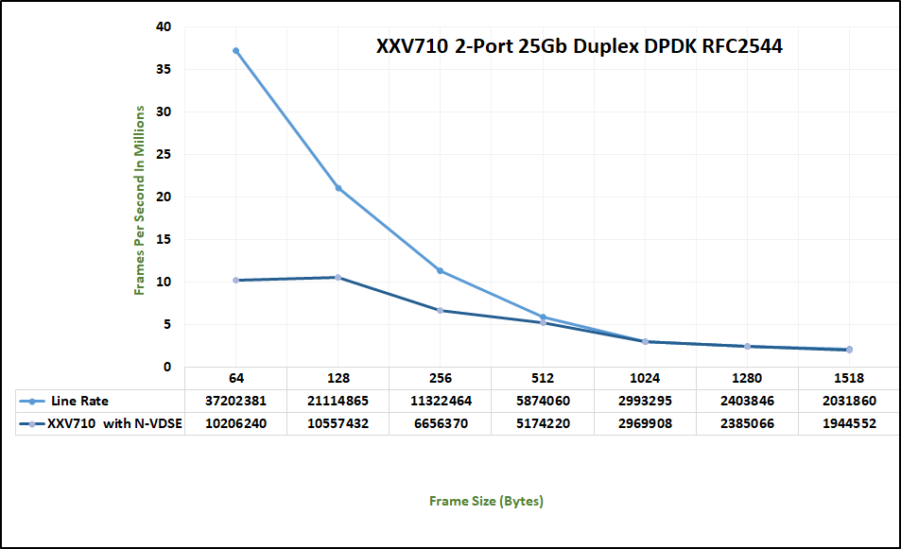
Throughput for VMWare vCloud 3.1 NVDS-E(NIC Validation team)

